Slide 1


Cryptocurrency Market Data Analysis
ALY6040 81061 Data Mining Applications

Slide 2

Introduction
What is Cryptocurrency?
Advantages
Drawback

Slide 3

Problem Statement
What cryptocurrency one should invest on(Bitcoin, Ethereum, Ripple)?

Slide 4

Analysis
Candlestick chart
Time series Analysis
Prediction Algorithm

Slide 5

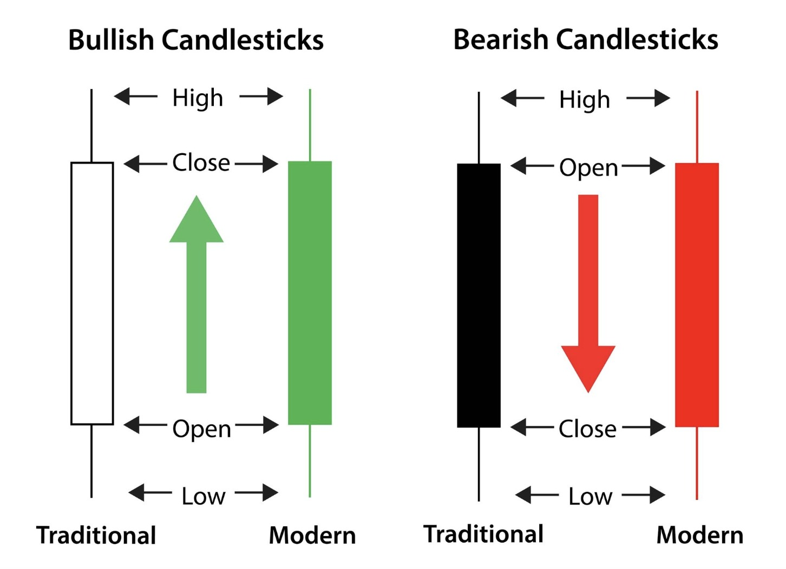



Candlestick Chart

Slide 6
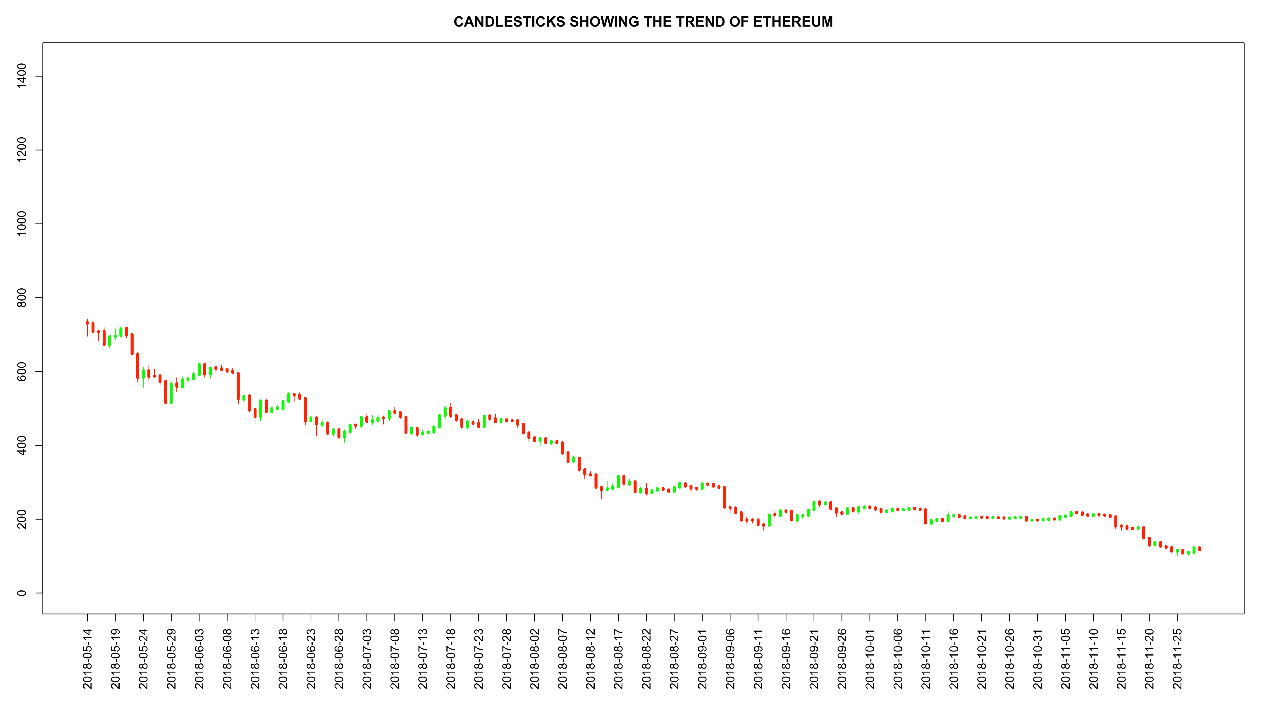
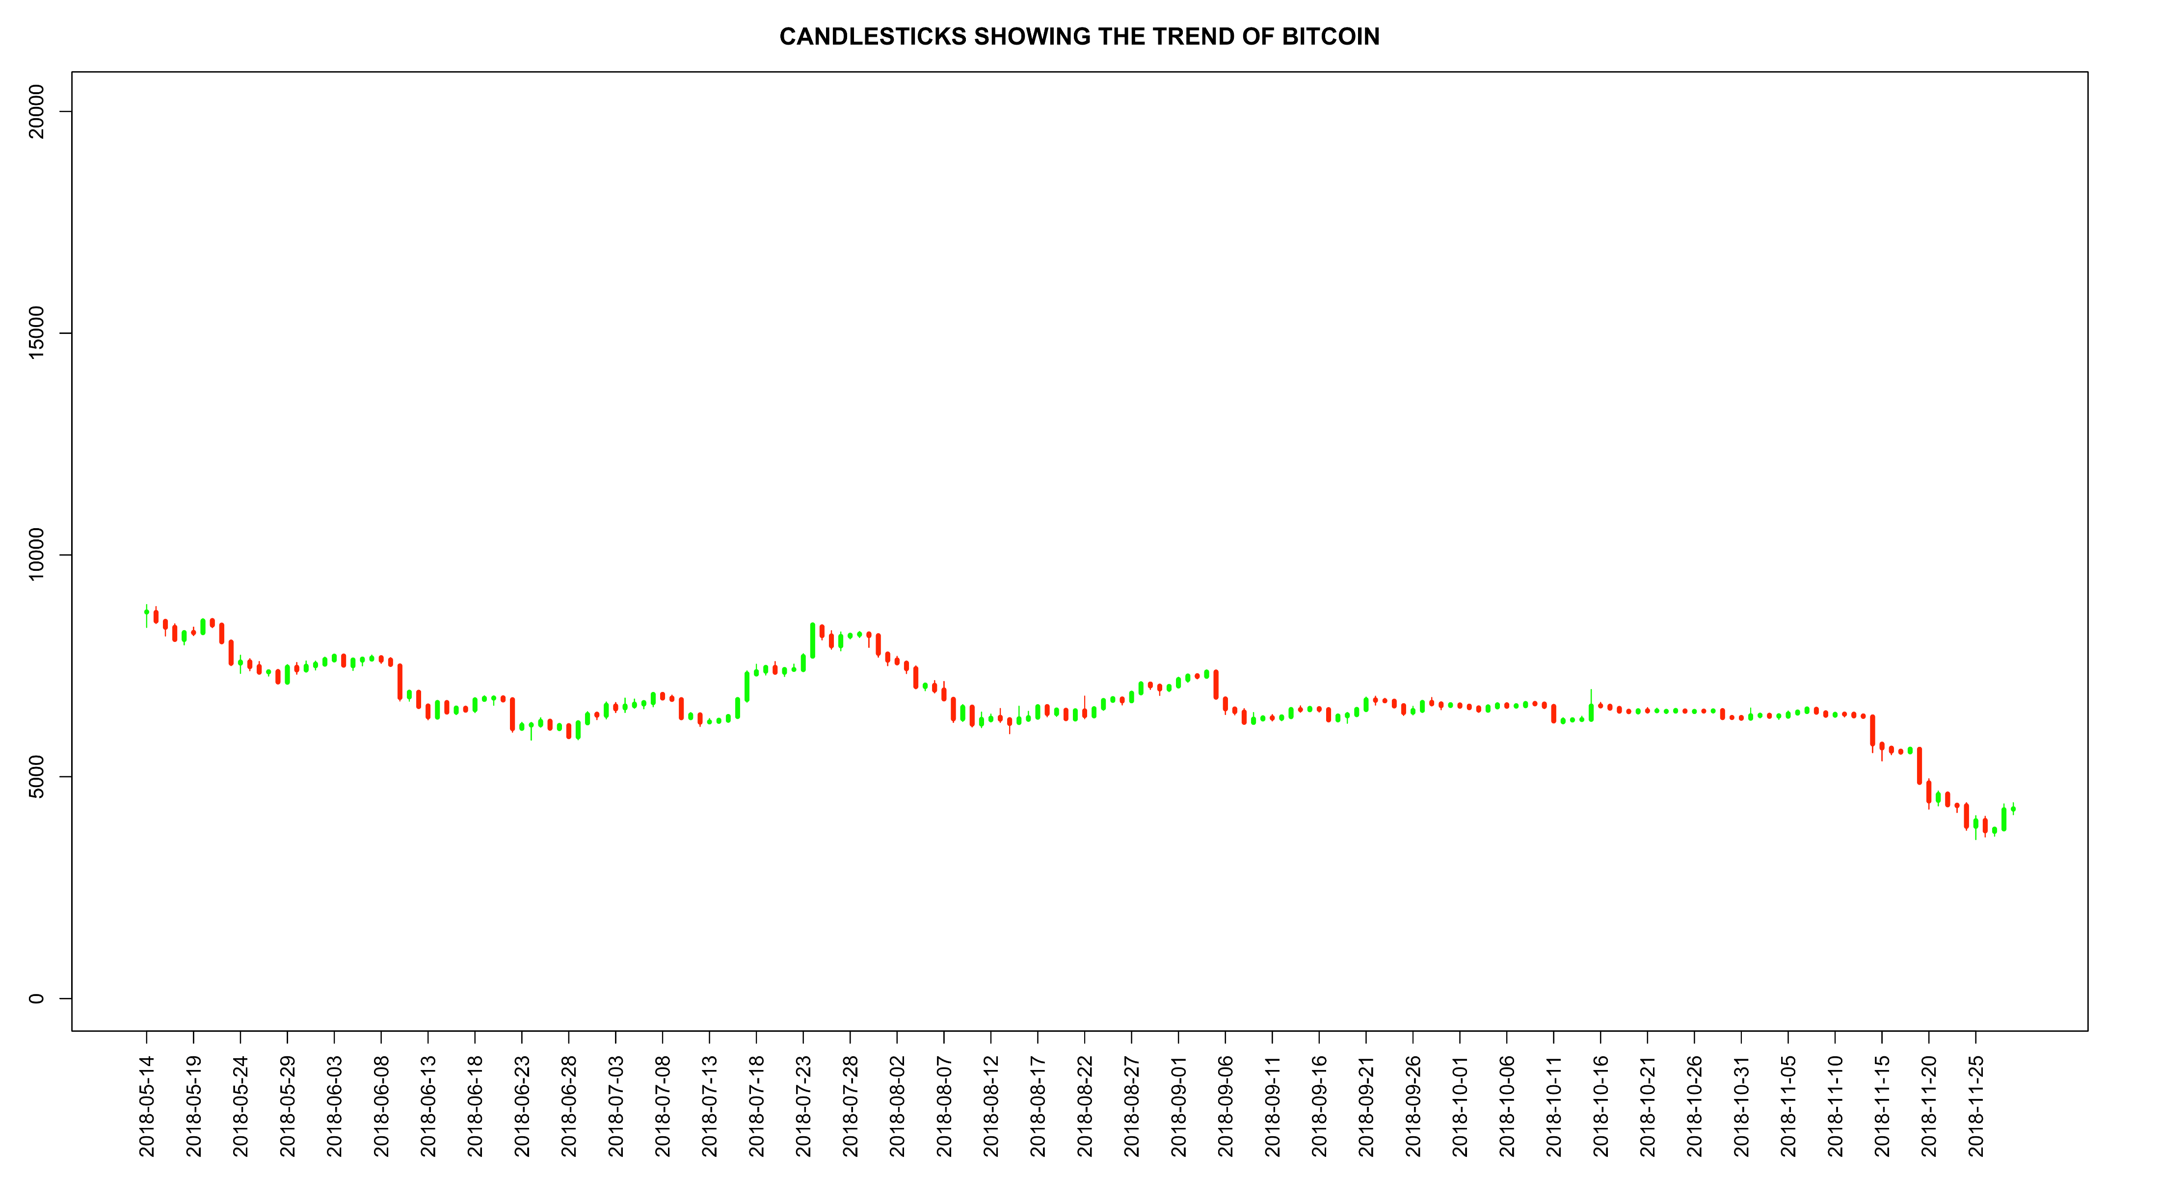
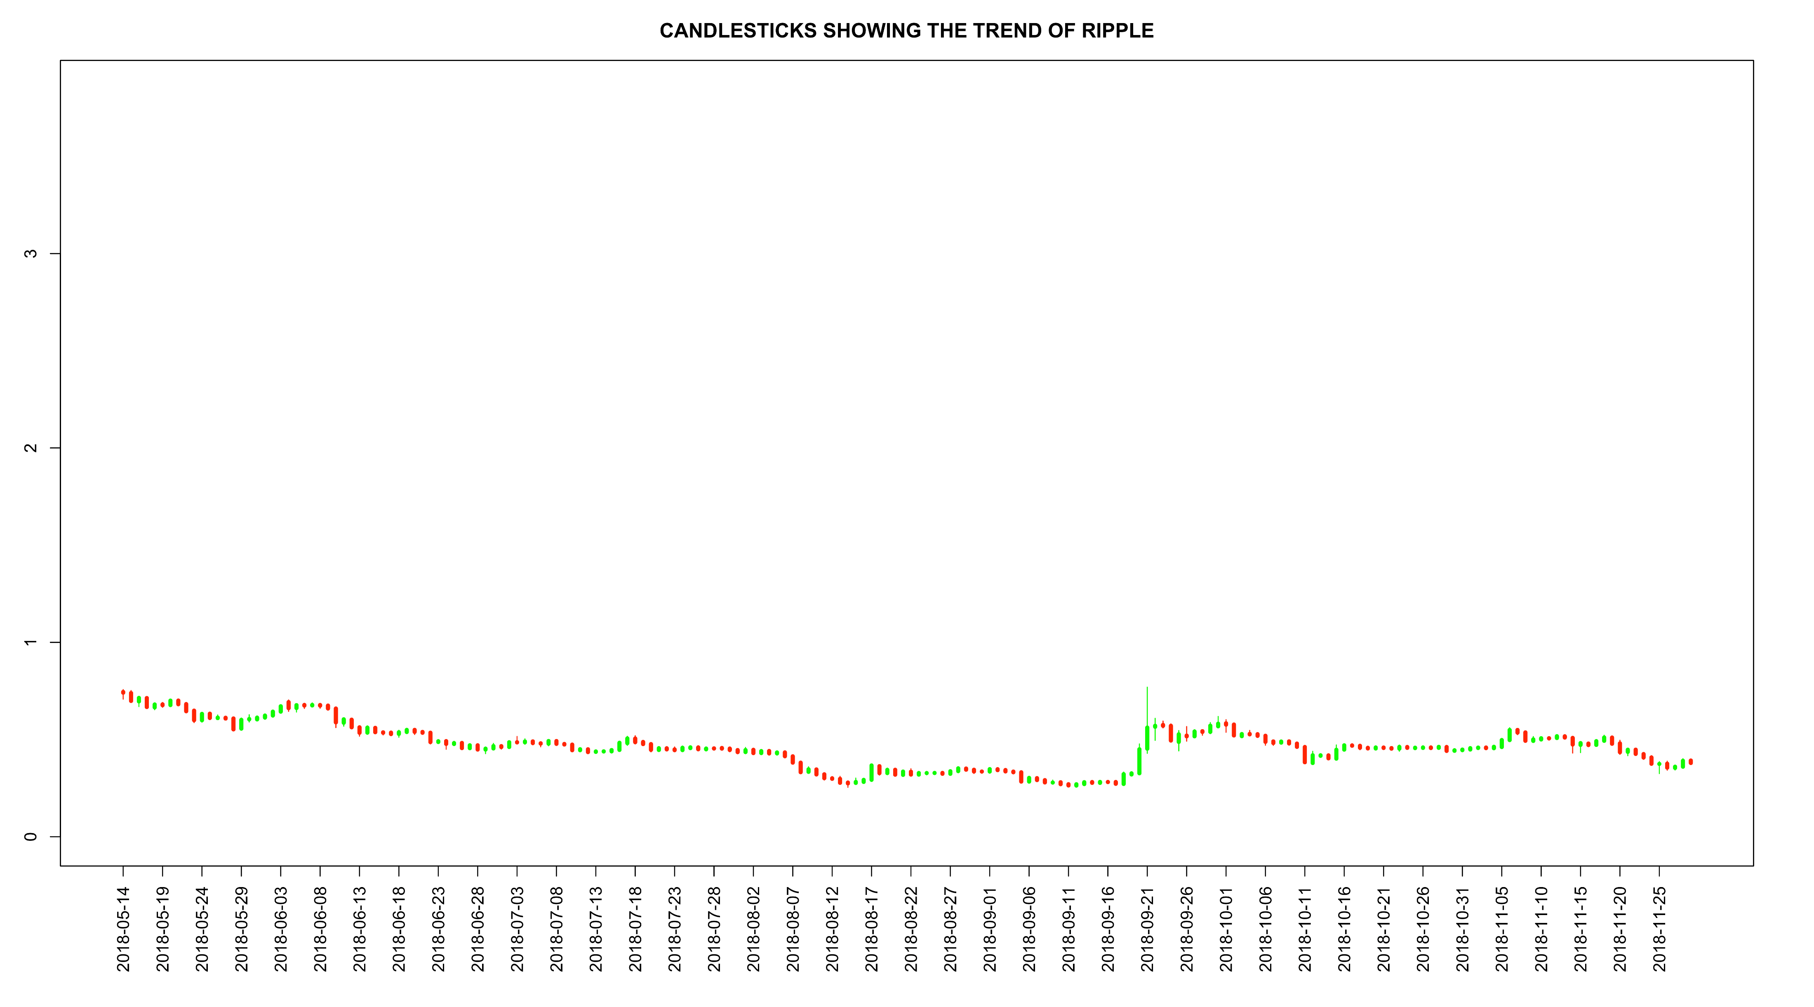

Slide 7
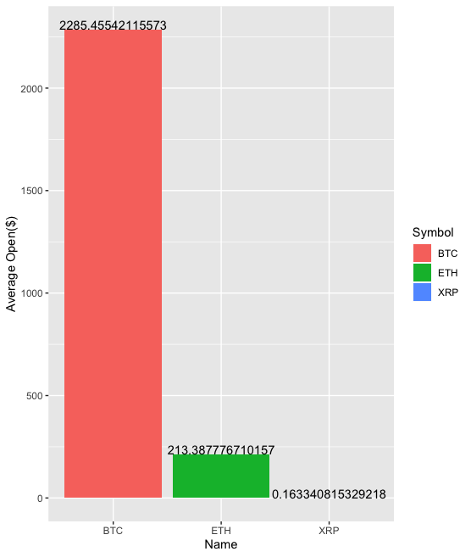
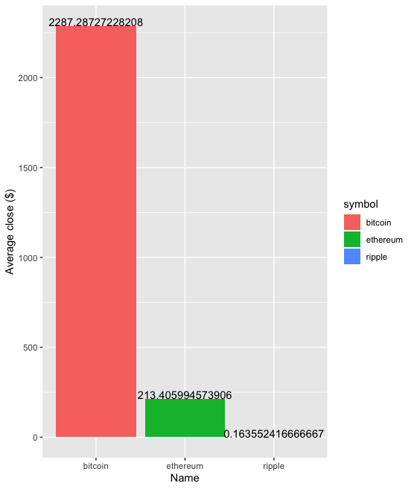
Average Open
Average Close

Slide 8

Time Series Analysis
Time series analysis is a statistical technique which deals with trend analysis.
Using six years of data (2013-2019), we intend to apply ARIMA model or Random Forest model or the model that better suits to analyze the trend of the best cryptocurrency over six years of time

Slide 9
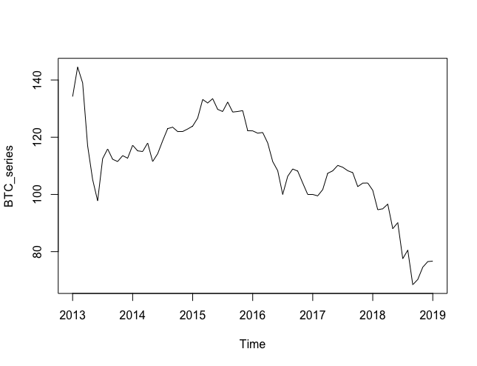

Slide 10
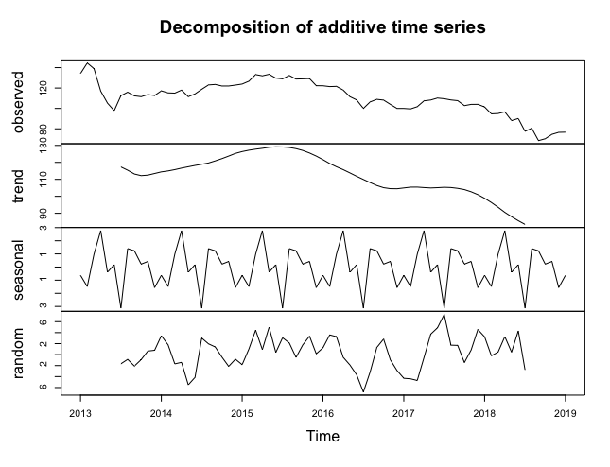

Slide 11
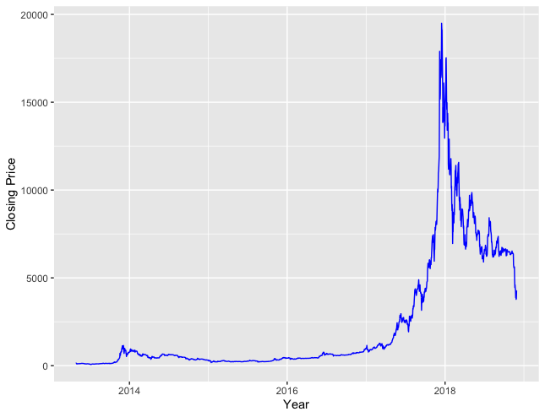
Results

Slide 12
Prediction Algorithm
Use of Prophet Model on time series data
Forecast price of cryptocurrency 180 days in future
Graph shows the increase in the value of Bitcoin from mid 2017
Further breakdown the analysis on raw data to get graphs for daily , weekly, monthly basis

Slide 13
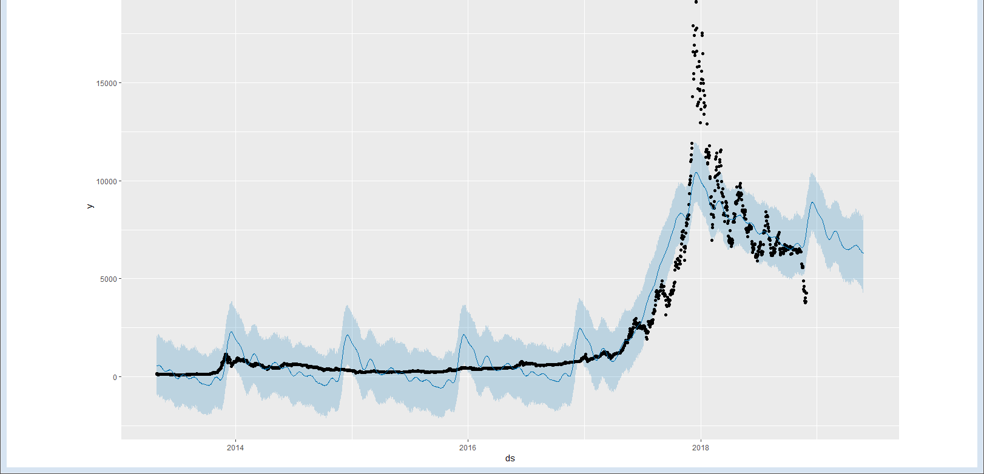

Slide 14
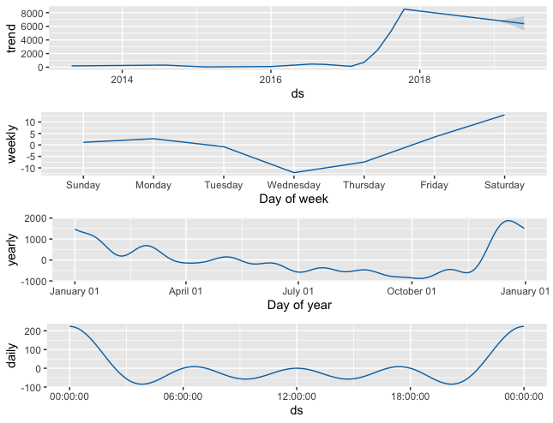

Slide 15
Conclusion
Bitcoin covers maximum market of cryptocurrencies.
Bitcoin proves to be a better option as it has smaller deviations in the market value.
Investors should focus on investing more in these.
Even if the bitcoin values fall they should not withdraw their money, there are higher chances that the values will increase again.

Slide 16

Thank you
Team Members:
Karishma Padale

